Slide 1
Creating
and
Managing
Tables

Slide 2
Objective
Create main database objects
Create tables
Describe the data types that can be used when specifying column definition
Alter table definition
Drop, rename, truncate tables

Slide 3
Database Objects
Objects | Description
Table | Basic unit storage ; composed of rows and columns
View | Logically represents subset of data from one or more tables
Sequence | Numeric value generator
Index | Improves the performance of some queries
Synonyms | Give alternate names to objects

Slide 4
Naming Rules
Table names and Column name :
Must begin with letter
Must be 1 to 30 character long
Must contain only A-Z , a-z , 0-9 , _ , $ , #
Must not duplicate the name of another object owned by the same user.
Must not be an reserved word

Slide 5
Database Languages
DDL (Data Definition Language) statements
DML (Data Manipulation Language) statements
DCL/TCL (Data Control/ Transaction Control Language) statements

Slide 6
CREATE TABLE Statement
Purpose: To create a table
Syntax: CREATE TABLE <table name>
(column1 datatype (size), column2 datatype (size),………..,columnn datatype (size))
You specify :
- table name
- column name, column data type, column size

Slide 7
Create Table Example
SQL>CREATE TABLE dept ( deptno int, dname varchar(15), dloc varchar(10));
Table created.

Slide 8
ALTER TABLE Statement
Purpose: To alter the structure of the table. It has 3 variations:
Alter with add: used to add columns in an existing table.
Syntax: alter table <table name> add <new column name> datatype (size)
Example:
alter table emp add age int

Slide 9
Alter with drop: used to remove a column from an existing table
syntax: alter table <table name> drop <column
name>
Example: alter table emp drop age
Alter with modify: used to modify an existing column
syntax: alter table <table name> modify <column
name> new_datatype (new size)

Slide 10
DROP and Rename TABLE Statement
DROP Table statement
Purpose: To destroy a table permanently.
Syntax: drop table <table name>
Example: drop table Employee
Rename table statement
Purpose: To rename an existing table.
Syntax: rename table <old table name> to <new table name>
Example: rename table Emp to Employee

Slide 11
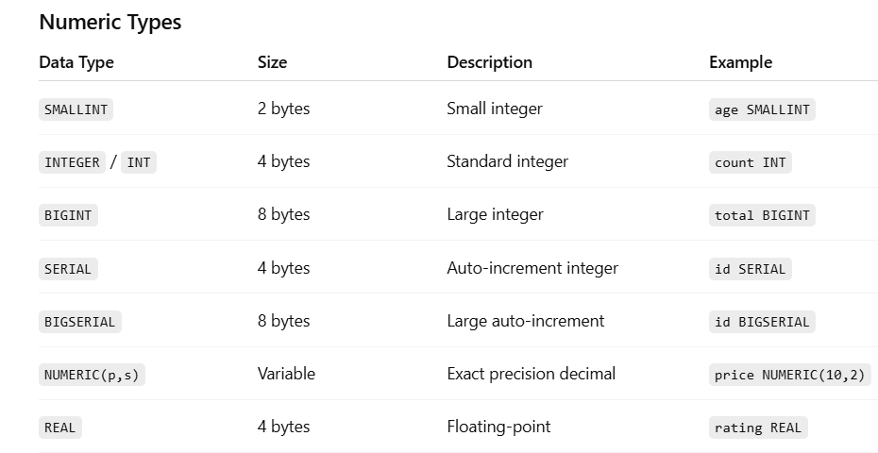
Data Types

Slide 12
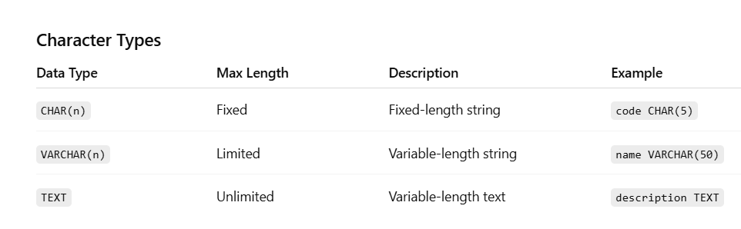

Slide 13
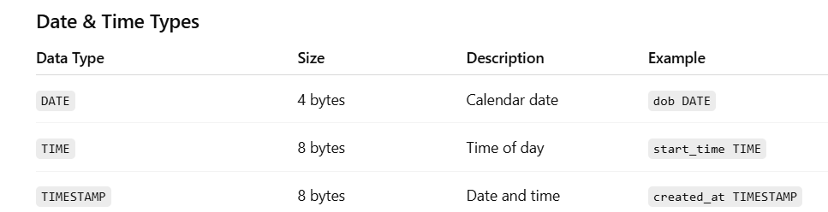

Slide 14
Manipulating Data

Slide 15
Objectives
Insert rows into table
Update rows in a table
Delete rows from a table
Merge rows in a table
Describe each DML statement
Control Transactions

Slide 16
INSERT Statement Syntax
Add a new row to a table using the INSERT statement
SQL> INSERT INTO table [(column [,column…])] VALUES (value [, value…]);
Only one rows is inserted at a time with this syntax.

Slide 17
EXAMPLE
INSERT INTO Deposit(b_name,c_name,ac_no,balance) VALUES(‘BBSR’,’AYAAN’,12345,5000);
OR
INSERT INTO Deposit VALUES(‘BBSR’,’AYAAN’,12345,5000);

Slide 18
Insert in a group
INSERT INTO employee (emp_id, name, dept_id, salary, joining_date) VALUES (1, 'Alice', 101, 50000, '2025-01-15'), (2, 'Bob', 102, 45000, '2025-02-20'), (3, 'Charlie', 101, 55000, '2025-03-10');

Slide 19
Step 1: Open any web browser and visit (Make sure you are connected to campus internet):
http://192.168.1.17/adminer.php
Step 2: In the Adminer login page:
System: Select PostgreSQL
Username: Enter your SIC number (in all lowercase)
Password: Enter your SIC number (in all lowercase)
Database: cse_db

Slide 20
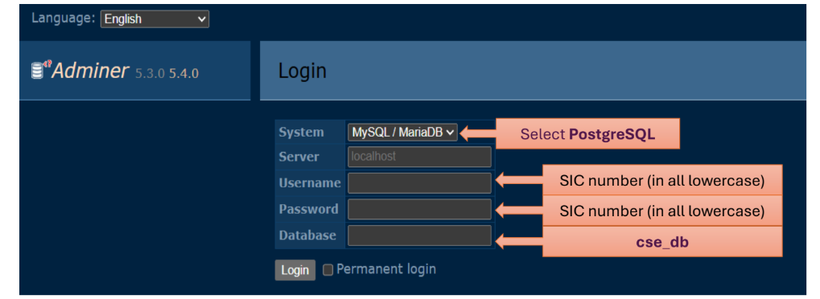

Slide 21
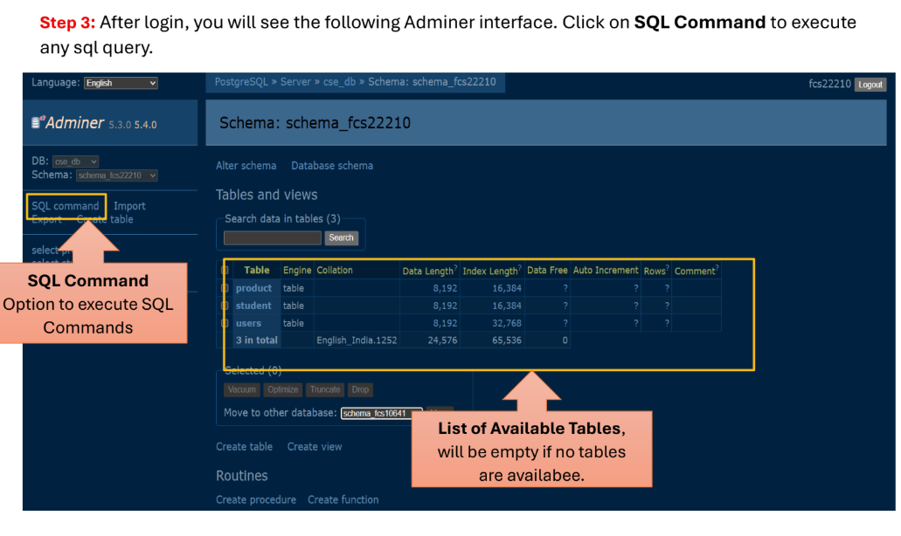

Slide 22
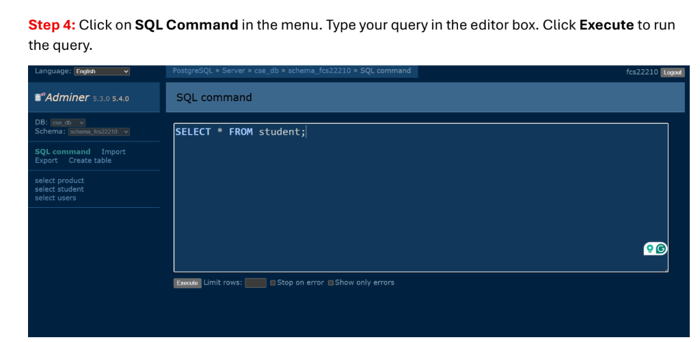

Slide 23


